Slide 1
Statistical Analysis
Topic: Measures of Center and Spread
EQ: What are mean and median and what are some examples of them?

Slide 2
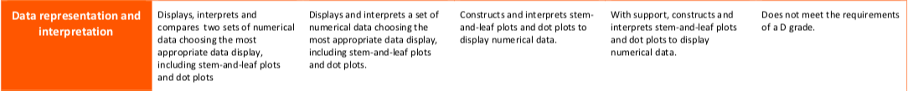
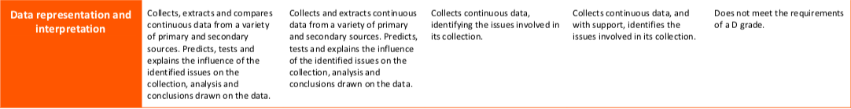

The Judging Standards for this unit (aka - How You will be Assessed!)

Slide 3
Measures of Center and Spread EQ: What are mean and median and what are some examples of them?
Summary:

Slide 4
Quickwrite
On your left hand side of your page (task side) do a quickwrite for 2 minutes about data.
A few prompts to start your quickwrite:
Why do we collect data?
When is data useful?
When have you collected data?

Slide 5
Up - Talk - Down
Everyone stand up and in groups of 3-4 read out your quickwrite and then sit down and listen to the rest of the group share.
After everyone in your group is sitting down again, add at least one more point to your quickwrite.

Slide 6
Measures of Center and Spread EQ: What are mode and range and how are they different?
There are four data measures (mean, median, mode and range) they help us to summarise and make sense of the data.
What are data measures?
What is the maximum number?
The largest number in the dataset
What is the minimum number?
The smallest number in the dataset

Slide 7
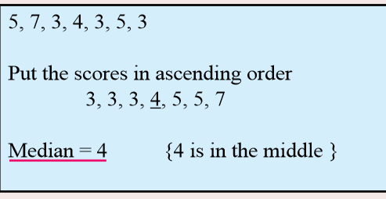
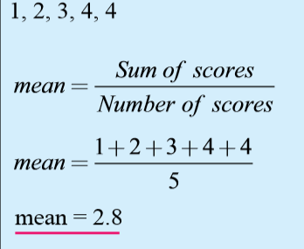
Measures of Center and Spread EQ: What are mean and median and what are some examples of them?
What is the median?
The middle number when the data is in order
What is the mean?
(also called the average)
The mean describes the middle of all the numbers.
First you add all of the numbers together and then divide by how many numbers there are.

Slide 8
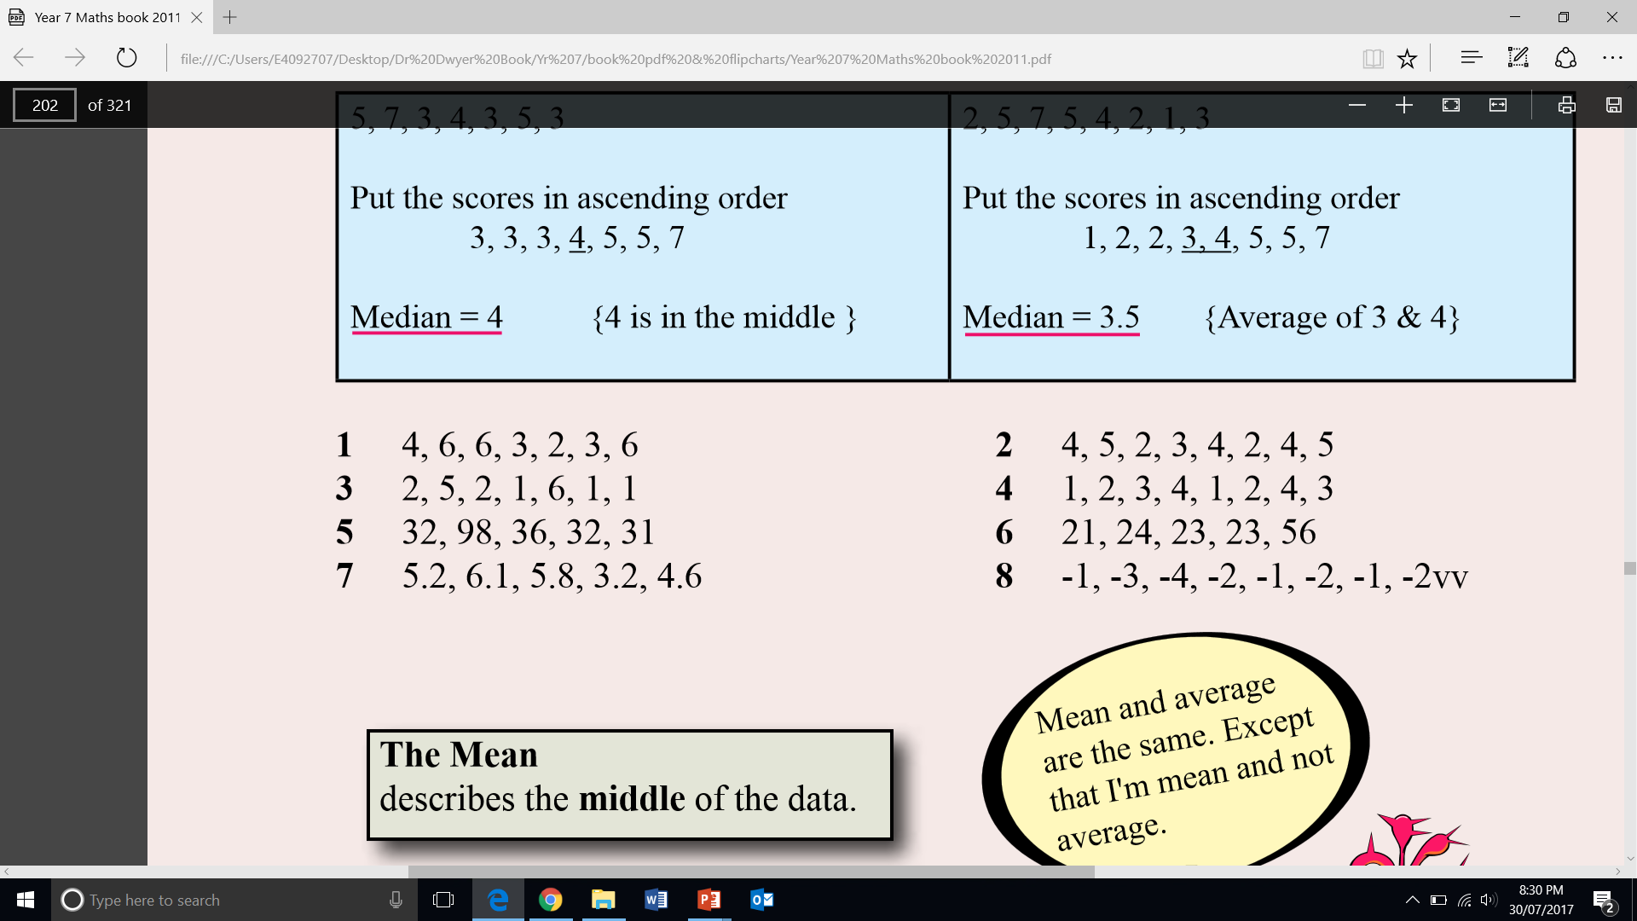
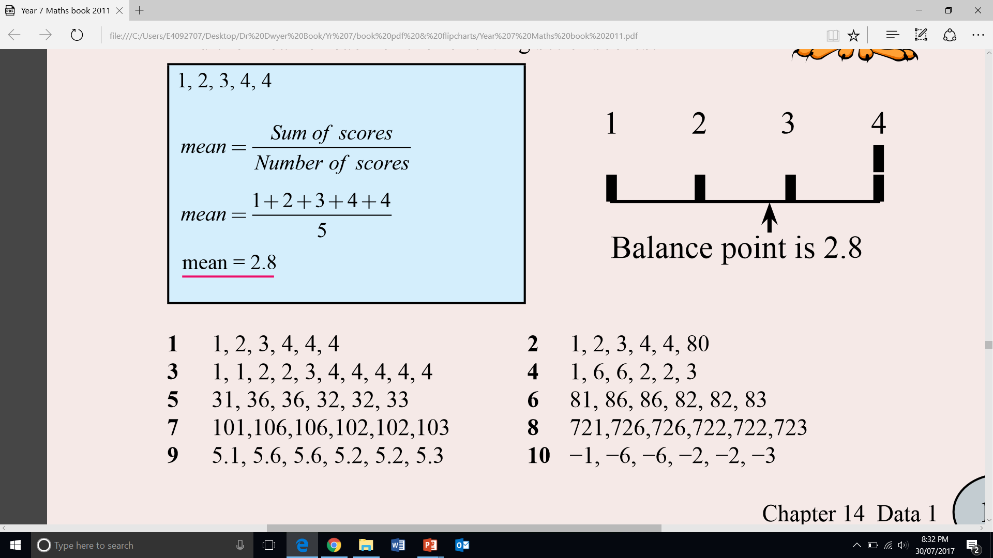
Guided Practice
Find the median:
Find the mean:

Slide 9
Independent practice
Find the median:
Find the mean:

Slide 10
Further Practice
Measures of central tendency foldable – just do mean and median
Freefall double-sided worksheet on median and mean

Slide 11
Measures of Center and Spread EQ: What are mean and median and what are some examples of them?
Complete your summary by answering the EQ
Summary:

Slide 12
Homework
Review Notes
List all new terms in glossary
Finish Freefall double-sided worksheet on median and mean

